Slide 1

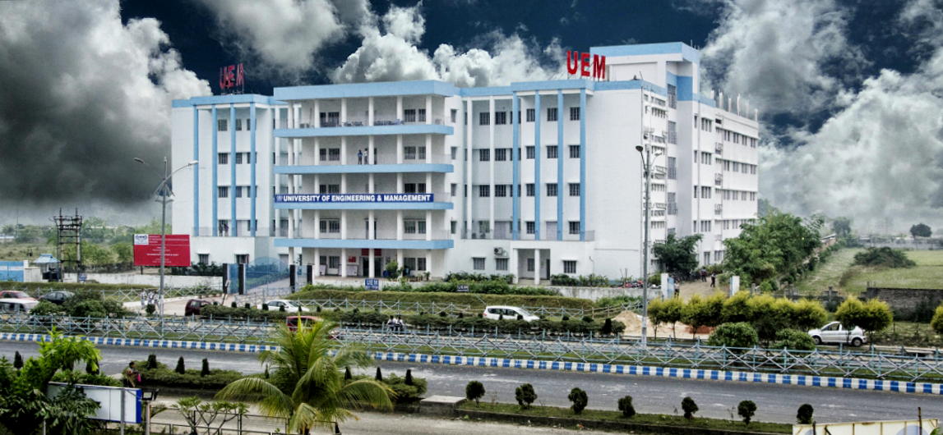
UNIVERSITY OF ENGINEERING & MANAGEMENT, KOLKATA
Course Name : AI & ML

Slide 2
 | UNIVERSITY OF ENGINEERING & MANAGEMENT, KOLKATA
What is Proposition?
A proposition (or a statement) is classified as a declarative sentence to which only one of the truth values. i.e. true or false.
Example: New Delhi is the capital of India. (T)
The square of 4 is 16. (T)
The cube of 5 is 122. (F)
Bring me coffee. (Not a proposition)

Slide 3
 | UNIVERSITY OF ENGINEERING & MANAGEMENT, KOLKATA
CONNECTIVES (PROPOSITIONAL CONNECTIVES OR LOGICAL CONNECTIVES)
There are five basic connectives:
(i) Negation (NOT)
(ii) Conjunction (AND)
(iii) Disjunction (OR)
(iv) Implication (IF THEN )
(v) If and Only If. (IFF)

Slide 4

 | UNIVERSITY OF ENGINEERING & MANAGEMENT, KOLKATA
P (Proposition) | NOT P
T | F
F | T
Truth Table for NOT
P | Q | P AND Q
F | F | F
F | T | F
T | F | F
T | T | T
Truth Table for AND

Slide 5
 | UNIVERSITY OF ENGINEERING & MANAGEMENT, KOLKATA
P | Q | P OR Q
F | F | F
F | T | T
T | F | T
T | T | T
Truth Table for OR

Slide 6
 | UNIVERSITY OF ENGINEERING & MANAGEMENT, KOLKATA
P | Q | P → Q
F | F | T
F | T | T
T | F | F
T | T | T
Truth Table for IF THEN

Slide 7
 | UNIVERSITY OF ENGINEERING & MANAGEMENT, KOLKATA
P | Q | P < - > Q
F | F | T
F | T | F
T | F | F
T | T | T
Truth Table for IF and only IF

Slide 8
 | UNIVERSITY OF ENGINEERING & MANAGEMENT, KOLKATA
Few Definitions:
When a statement cannot be logically broken into smaller statements, we call it atomic.
Let r be a propositional formula, constructed by connecting atomic propositions p, q, s, etc. by operators. An interpretation for r is a function that maps v (p), v (q) and v (s) into true or false values that together keep r true.

Slide 9
 | UNIVERSITY OF ENGINEERING & MANAGEMENT, KOLKATA
A propositional formula is called satisfiable if its value is true for some interpretation.
A propositional formula is unsatisfiable or contradictory if it is not satisfiable, i.e., for no interpretation it is true.
A propositional formula is called valid or tautology, when it is true for all possible interpretations.

Slide 10
 | UNIVERSITY OF ENGINEERING & MANAGEMENT, KOLKATA
Example
If P represents 'This book is good' and Q represents 'This book is cheap',
write the following sentences in symbolic form:
(a) This book is good and cheap.
(b) This book is not good but cheap.
(c) This book is costly but good.
(d) This book is neither good nor cheap.
(e) This book is either good or cheap.

Slide 11
 | UNIVERSITY OF ENGINEERING & MANAGEMENT, KOLKATA
Translate the following sentences into propositional forms:
(a) If it is not raining and I have the time, then I will go to a movie.
(b) It is raining and I will not go to a movie..
(c) It is not raining.
(d) I will not go to a movie.
(e) I will go to a movie if only if it is not raining.

Slide 12
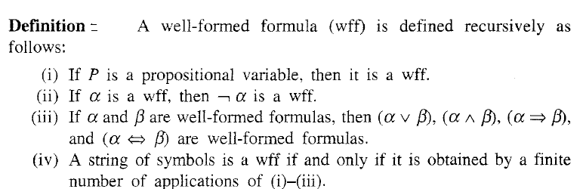
 | UNIVERSITY OF ENGINEERING & MANAGEMENT, KOLKATA
Well Formed Formula

Slide 13
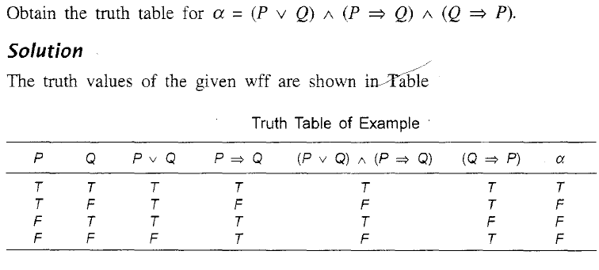
 | UNIVERSITY OF ENGINEERING & MANAGEMENT, KOLKATA
WFF Example

Slide 14
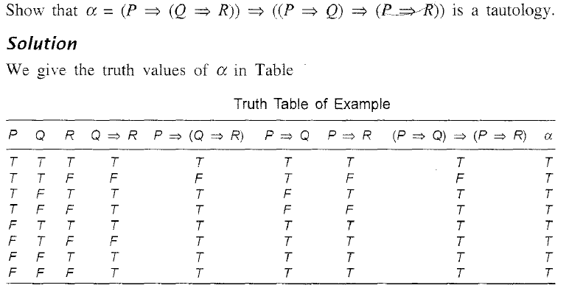
 | UNIVERSITY OF ENGINEERING & MANAGEMENT, KOLKATA

Slide 15
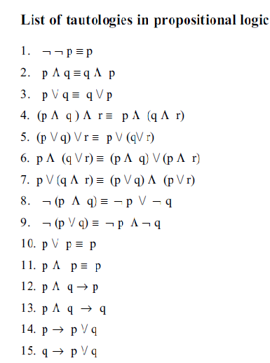
 | UNIVERSITY OF ENGINEERING & MANAGEMENT, KOLKATA

Slide 16
 | UNIVERSITY OF ENGINEERING & MANAGEMENT, KOLKATA
Theorem Proving by Propositional Logic
i) Semantic
ii) Syntactic
Semantic method involves forward chaining and backward chaining method.
Forward chaining: When all the premises are true, check whether the conclusion is true. Under this circumstance, we say that forward chaining holds good.
Backward chaining: When all the consequences are false, check whether at least one of the premises is false.

Slide 17
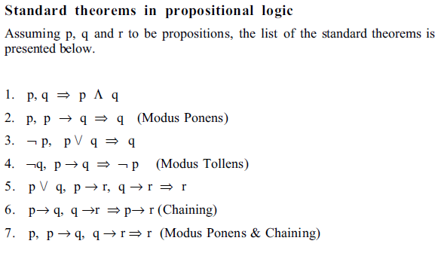
 | UNIVERSITY OF ENGINEERING & MANAGEMENT, KOLKATA

Slide 18
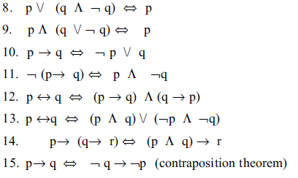
 | UNIVERSITY OF ENGINEERING & MANAGEMENT, KOLKATA

Slide 19
 | UNIVERSITY OF ENGINEERING & MANAGEMENT, KOLKATA
Approach for Syntactic Prove
Method of Substitution
By this method, left-hand side (or right-hand side) of the statement to be proved is chosen and the standard formulas, presented above, are applied selectively to prove the other side of the statement.
Ex : Prove the contraposition theorem.

Slide 20
 | UNIVERSITY OF ENGINEERING & MANAGEMENT, KOLKATA
RULES OF INFERENCE FOR PROPOSITIONAL CALCULUS
In logical reasoning, a certain number of propositions are assumed to be true and based on that assumption some other propositions are derived (deduced or inferred).
The propositions that are assumed to be true are called hypotheses or premises.
The proposition derived by using the rules of inference is called a conclusion.
The process of deriving conclusions based on the assumption of premises is called a valid argument.

Slide 21
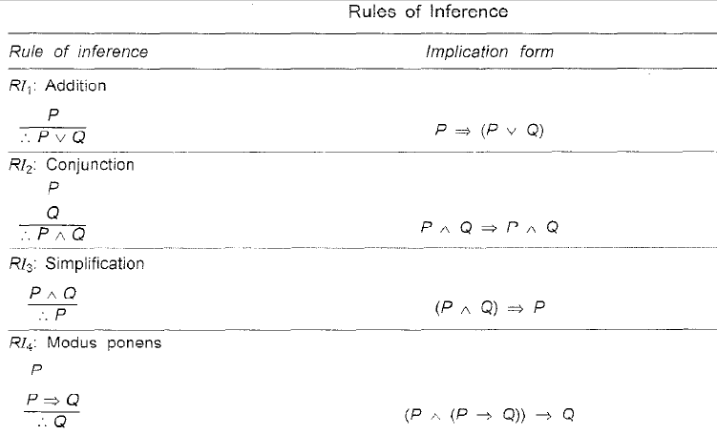
 | UNIVERSITY OF ENGINEERING & MANAGEMENT, KOLKATA

Slide 22
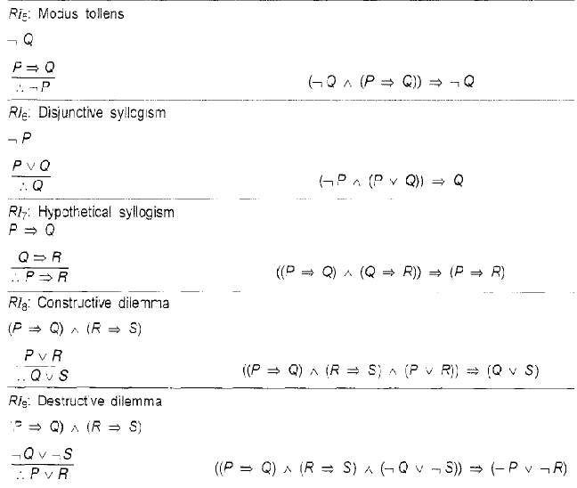
 | UNIVERSITY OF ENGINEERING & MANAGEMENT, KOLKATA

Slide 23
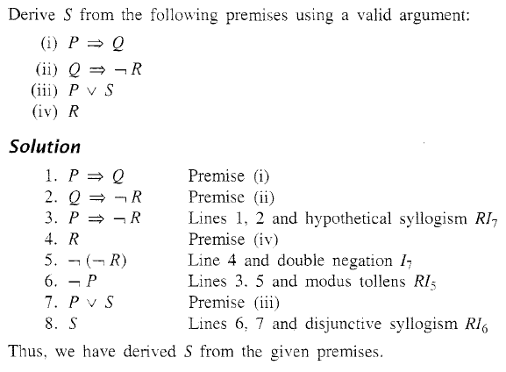
 | UNIVERSITY OF ENGINEERING & MANAGEMENT, KOLKATA

Slide 24
 | UNIVERSITY OF ENGINEERING & MANAGEMENT, KOLKATA
Check the validity of the following argument:
If Ram has completed B.E. (Computer Science) or MBA, then he is assured of a good job. If Ram is assured of a good job, he is happy. Ram is not happy. So Ram has not completed MBA.

Slide 25
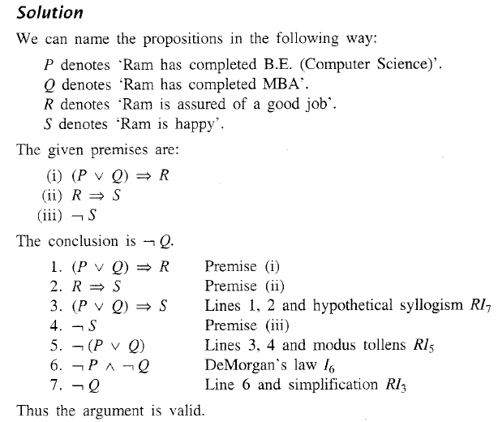
 | UNIVERSITY OF ENGINEERING & MANAGEMENT, KOLKATA

Slide 26
 | UNIVERSITY OF ENGINEERING & MANAGEMENT, KOLKATA
Resolution in Propositional Logic
Resolution theorem:
For any three clauses p, q and r,
p ∨ r, q ∨ ￢ r ⇒ p ∨ q
The resolution theorem can also be used for theorem proving and reasoning in propositional logic.

Slide 27
 | UNIVERSITY OF ENGINEERING & MANAGEMENT, KOLKATA
Resolution algorithm
Input: A set of clauses, called axioms and a goal.
Output: To test whether the goal is derivable from the axioms.
Begin
1. Construct a set S of axioms plus the negated goal.
2. Represent each element of S into conjunctive normal form (CNF) by the following steps:
a) Replace ‘if-then’ operator by NEGATION and OR operation by theorem 10.
b) Bring each modified clause into the following form and then drop AND operators connected between each square bracket. The clauses thus obtained are in conjunctive normal form (CNF). It may be noted that pij may be in negated or non-negated form.
[ p 11 ∨ p12 ∨ …….. ∨ p1n ] ∧
[ p21 ∨ p22∨….. …∨ p2n ] ∧
……………………………………………
[ pm1 ∨ p m2 ∨ ∨ pm n ]

Slide 28
 | UNIVERSITY OF ENGINEERING & MANAGEMENT, KOLKATA
3. Repeat
a) Select any two clauses from S, such that one clause contains a negated literal and the other clause contains its corresponding positive (non-negated) literal.
b) Resolve these two clauses and call the resulting clause the resolvent. Remove the parent clauses from S.
Until a null clause is obtained or no further progress can be made.
4. If a null clause is obtained, then report: “goal is proved”.

Slide 29
 | UNIVERSITY OF ENGINEERING & MANAGEMENT, KOLKATA
Example:
Consider the following knowledge base:
1. The-humidity-is-high ∨ the-sky-is-cloudy.
2. If the-sky-is-cloudy then it-will-rain
3. If the-humidity-is-high then it-is-hot.
4. it-is-not-hot
and the goal : it-will-rain.

Slide 30
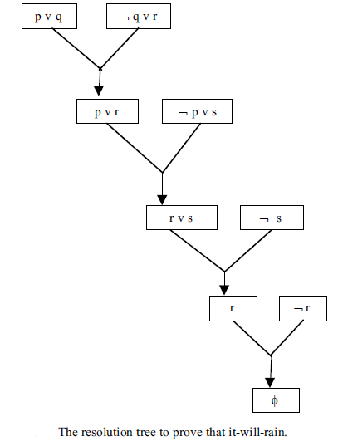
 | UNIVERSITY OF ENGINEERING & MANAGEMENT, KOLKATA

Slide 31
 | UNIVERSITY OF ENGINEERING & MANAGEMENT, KOLKATA
Soundness and Completeness
Soundness refers to the correctness of the proof procedure.
Completeness implicates that all the possible inferences can be derived by using the algorithm.

Slide 32
 | UNIVERSITY OF ENGINEERING & MANAGEMENT, KOLKATA
Predicate Logic
Predicate logic (also called first order predicate logic) has a similar formalism like propositional logic.
It includes two more quantifiers, namely, the essential quantifier (∀) and the existential quantifier (∃).

Slide 33
 | UNIVERSITY OF ENGINEERING & MANAGEMENT, KOLKATA
Knowledge 1 : All boys like sweets.
Using predicate logic, we can write the above statement as
∀ X ( Boy ( X ) → Likes (X , sweets))
Knowledge 2 : Some boys like flying kites.
Using predicate logic, the above statement can be represented as
∃X ( Boy (X) → Likes (X, Flying-kites))
Note: The symbol ∀ can be read as 'for every', 'for any', 'for each', 'for arbitrary'. The symbol ∃ can be read as 'for some', for 'at least one'.

Slide 34
 | UNIVERSITY OF ENGINEERING & MANAGEMENT, KOLKATA
Alphabets of FOL
1. Constants: a, b, c
2. Variables: X, Y, Z
3. Functions: f, g, h
4. Operators: Λ, ∨ , ￢ , →
5. Quantifiers: ∀ , ∃
6. Predicate: P, Q, R

Slide 35
 | UNIVERSITY OF ENGINEERING & MANAGEMENT, KOLKATA
Few Definitions:
A term is defined recursively as being a constant, variable or the result of application of a function to a term.
e.g., a, x, t(x), t(g(x)) are all terms.
Function denotes relations defined on a domain D. They map n elements (n >0) to a single element of the domain. “father-of”, “age-of” represent function symbols.
Predicate symbols denote relations or functional mappings from the elements of a domain D to the values true or false. Capital letters such as P,Q, MARRIED, EQUAL are used to represent predicates.

Slide 36
 | UNIVERSITY OF ENGINEERING & MANAGEMENT, KOLKATA
Express the following sentences involving predicates in symbolic form:
1. All students are clever.
2. Some students are not successful.
3. Every clever student is successful.
4. There are some successful students who are not clever.
5. Some students are clever and successful.

Slide 37
 | UNIVERSITY OF ENGINEERING & MANAGEMENT, KOLKATA
The sentences of FOL are well-formed-formulas (WFF), defined as follows:
1. If P (t1, t2, … , tn) is an n-ary predicate, then P is an atomic formula.
2. An atomic formula is a well-formed formula (WFF).
3. If P and Q are WFF then P ∧ Q, P ∨ Q, ￢ P, P → Q are all WFF. Note that ∀X R (X) is also an WFF.
4. If P is a WFF and X is not a quantified variable in P, then P remains a WFF even after quantification
e.g., ∀X P or ∃X P are WFF.

Slide 38
 | UNIVERSITY OF ENGINEERING & MANAGEMENT, KOLKATA
A predicate formula is valid if for all possible assignments of values from any universe of discourse to free variables, the resulting propositions have the truth value T.
A predicate formula is satisfiable if for some assignment of values to predicate variables the resulting proposition has the truth value T.
A predicate formula is unsatisfiable if for all possible assignments of values from any universe of discourse to predicate variables the resulting propositions have the truth value F.

Slide 39
 | UNIVERSITY OF ENGINEERING & MANAGEMENT, KOLKATA
Rewrite the following sentences in FOL.
1. Coconut-crunchy is a biscuit.
2. Mary is a child who takes coconut-crunchy.
3. John loves children who take biscuits.
4. John loves Mary.
The above statements can be represented in FOL using two quantifiers X & Y.
1. Biscuit (coconut-crunchy)
2. Child (mary) ∧ Takes (mary, coconut-crunchy)
3. ∀X ((Child (X ) ∧ ∃Y (Takes (X, Y) ∧ Biscuit (Y ))) →Loves
(john, X)
4. Loves (john, mary)

Slide 40
 | UNIVERSITY OF ENGINEERING & MANAGEMENT, KOLKATA
RULES OF INFERENCE FOR PREDICATE CALCULUS
All the rules of inference for the proposition formulas are also applicable to predicate calculus wherever necessary.
For predicate formulas not involving connectives such as A(x), P(x, y). We can get equivalences and rules of inference.

Slide 41
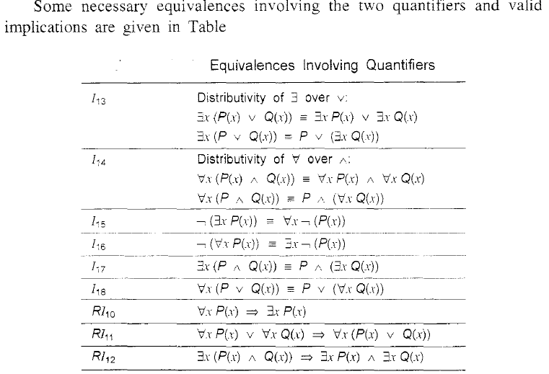
 | UNIVERSITY OF ENGINEERING & MANAGEMENT, KOLKATA

Slide 42
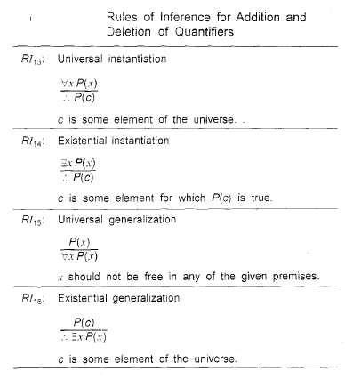
 | UNIVERSITY OF ENGINEERING & MANAGEMENT, KOLKATA

Slide 43
 | UNIVERSITY OF ENGINEERING & MANAGEMENT, KOLKATA
Example:
Discuss the validity of the following argument:
All graduates are educated.
Ram is a graduate.
Therefore. Ram is educated

Slide 44
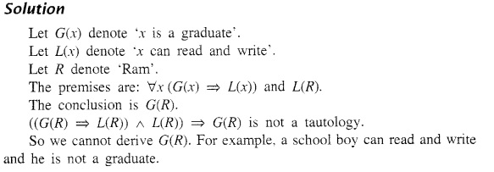
 | UNIVERSITY OF ENGINEERING & MANAGEMENT, KOLKATA

Slide 45
 | UNIVERSITY OF ENGINEERING & MANAGEMENT, KOLKATA
Robinson’s Inference Rule
Consider predicates P, Q1, Q2 and R.
Let us assume that with appropriate substitution S, Q1 [S] = Q2 [S] .
Then (P ∨ Q1) ∧ (Q2 ∨ R) with Q1 [S] = Q2 [S] yields ( P ∨ R) [S].

Slide 46
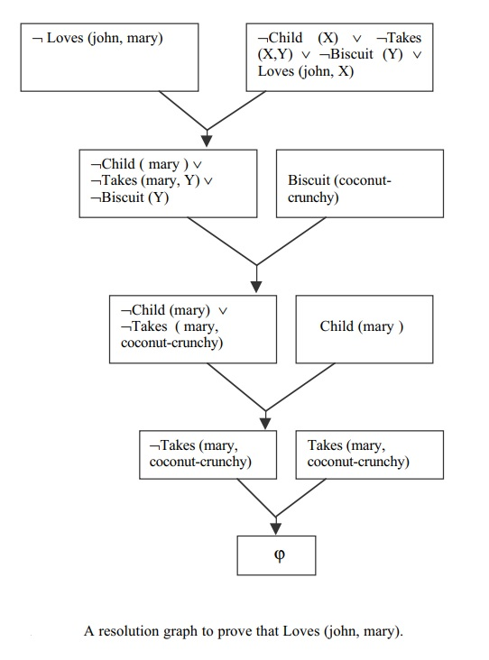
 | UNIVERSITY OF ENGINEERING & MANAGEMENT, KOLKATA

Slide 47
 | UNIVERSITY OF ENGINEERING & MANAGEMENT, KOLKATA
Concept of Semi-decidability
A sound and complete proof method is able to prove the validity of a formula. But if the formula is invalid, the proof procedure (by resolution principle or otherwise) will never terminate. This is called semi-decidablity. FOL is semi-decidable, as it is unable to prove the invalidity of a formula.

Slide 48

 | UNIVERSITY OF ENGINEERING & MANAGEMENT, KOLKATA
Thank You

